Slide 1

Blockchain and Solidity
Learn how to code your first smart contract and run a private blockchain in order to interact with it !
By Leon Ducasse

Slide 2
Summary
Introduction to blockchain and its principles
Focus on Ethereum
What is a smart contract and how it works
Create your first contract with solidity on remix
Deploy your contract on remix
Run your private blockchain and deploy your contract on it
Deploy your contract on a testnet and interact with the contract of your friends
Learn more about solidity

Slide 3
Simple schema of a blockchain
- Hash of the previous block
- Timestamp
- Nonce
- Hash of all transactions
- Hash of the previous block
- Timestamp
- Nonce
- Hash of all transactions
All transactions
All transactions
Notes:
How do you make sure users actually have the bitcoins they claim to have when they spend them? How to ensure that they do not spend the same bitcoins with several people at the same time?
With the Internet, we are able to transfer information very easily. I can send you a music file and you can download it to your computer. I will keep it on my post and you will have a copy on yours.
With money, it's a little different.
If I send you bitcoins, it is desirable that I no longer have them and cannot send them to another.
It's also desirable that I can't roll back once the transaction is committed.
Blockchain: distributed database that records the signed transactions of its users by grouping them into blocks, cryptographically linked to each other, and which uses a consensus method to synchronize the different nodes / servers of its network with each other.
Here we have a first approach to blockchains. We have two blocks following each other. At the top, the "header". And below all the transactions listed on this block.
We can see that the header of the block is made up of several elements. Previous hash, timestamp, nonce, transaction hash.
What must be understood here is that the main technical property of blockchain technology is that all the blocks follow each other, with a link that is made by registering a property of the previous block, which makes it possible to truly trace a chain of blocks, and therefore an unfalsifiable history.

Slide 4

The consensus
PROOF OF WORK
PROOF OF STAKE
Right version of the blockchain ?
No computer power
pledge a certain amount (deposit)
most computing power invested
potentially granted the right to validate transactions
register them in a block
WHY ?
spending computer computing power has a cost
in material and energy, and cannot be falsified
Try to falsify ?
whole network will notice it,
created block will be cancelled,
deposit will be taken back
Miners
‘slashing’
Remunerated with the cryptocurrency of the blockchain
not particular equipment or energy expenditure
Notes:
The first thing to understand about (public) blockchains is that as distributed databases, they operate on a decentralized network, consisting of an unpredictable number of interconnected servers that all apply the same rules to arrive at a consensus on the state of the database at a time t.
Before even knowing how transactions take place, there is therefore a fundamental IT problem that must be solved first. How to ensure that all the nodes (all the servers) of this network have the same version of the database?
How to ensure that updates to this database (new transactions or new blocks) are performed on all nodes in a similar way?
How to manage the fact that nodes can enter or leave the network at any time?
And finally, how to ensure that a "renegade" node, which would like to distribute an erroneous or censored version (without the expense of the person who controls the node for example..) of the database cannot do so?
Answering these questions is a field of research on its own in computer science: consensus methods in distributed networks.
Several solutions exist, we will detail the one used on the Bitcoin network, then another consensus present on other blockchains: proof of work (proof of work - PoW), then proof of stake (proof of stake - PoS)
BITCOIN AND PROOF OF WORK
The general idea of proof of work is ultimately quite simple: the version of the blockchain (of the database) that is accepted as the good one is the one in which the most computing power has been invested.
Why ? Because spending computer computing power has a cost, in material and energy, and cannot be falsified.
When a computer has performed a complex calculation, it can prove it simply by providing the result.
Concretely: those who we will call Miner (who will mine blocks) will make complex calculations to find the solution to a problem posed by the blockchain.
If they get there before the others, then they are allowed to take the current transactions and put them in a block. The network then sees the block being deployed and eventually accepts it as a block of the blockchain.
The network will then remunerate the miner by offering him value, the cryptocurrency of the blockchain.
PROOF OF STAKE
This is easier to understand than proof of work. Here, no need for computer power. If before we proved our good faith in energy expenditure, here we spend value: the cryptocurrency associated with the blockchain.
We pledge a certain amount, against which we are potentially granted the right to validate transactions and register them in a block.
Pledging the requested amount acts as a deposit: if the transactions are not correctly registered, if one tries to falsify them, then the whole network will notice it, and the created block will be cancelled, and our deposit will be taken back: this is called slashing.
This consensus method therefore does not require any particular equipment, or energy expenditure (which is well suited in a world where energy is rare, expensive, and its expenditure is partly bad for the planet, so it is appreciated today.).
In the same way that we reward miners in PoW, we also reward stakers. The consensus admits particularities according to the blockchains, but we often come to a draw of the stakers who will be able to register the block.

Slide 5


The nodes
Computer in the blockchain network,
stores a copy of the blockchain and participates in the consensus process
Different clients
software that allows global access to the blockchain
± 14.000 active nodes on Bitcoin
mine or stake
see pending transactions
send transactions to the network
check the status of the blockchain
retrieve information on it
…
Uses Bitcoin Core client
Many different clients available for Ethereum
± 7500 active nodes
(see useful links in the ‘notes’ of this slide)
Notes:
Whether on Bitcoin, Ethereum or any blockchain, we need to decentralize the network. This requires consensus between the actors. There must still be actors. Who are able to see transactions, synchronize, mine...
To do this, blockchain players will use blockchain clients to become a network node.
A node is a computer in the blockchain network that stores a copy of the blockchain and participates in the consensus process.
THE CLIENTS
These blockchain clients are software that will allow global access to the blockchain. They therefore allow you to mine or stake, see pending transactions, send transactions to the network, check the status of the blockchain, retrieve information on it...
They are of paramount importance, since they are the ones who will guarantee the proper functioning of the blockchain.
SOME EXAMPLES
(Might not be up to date)
On Bitcoin, there are now about 14,000 active nodes, of which about 7,500 on average are available at all times that allow the decentralization of the network (figure available here: https://bitnodes.io/)
All use a different implementation from a client called Bitcoin Core. Other clients are not at the level on Bitcoin (here is a study if you want to go further: https://blog.lopp.net/2021-bitcoin-node-performance-tests-2/)
On Ethereum, according to the official doc, there are several available clients.
https://ethereum.org/en/developers/docs/nodes-and-clients/#execution-clients
On the other hand, what can be seen in the facts is that Geth represents a large part of the active nodes: https://ethernodes.org/
Moreover, at the time of writing these lines there are 7500 nodes active on Ethereum according to this same site.
The client question is a fundamental question in the execution of a blockchain. Indeed, several elements must be taken into account in the development and use of a client
• its simplicity of implementation, so that as many people as possible can support the network
• its execution speed, to be always up to date on the blocks to be synchronized
• the customer's update speed to stick to network needs
• the safety of the customer
• his free code
• and above all, there is a certain need to have a plurality of customers, to avoid centralization around software that could be faulty.

Slide 6
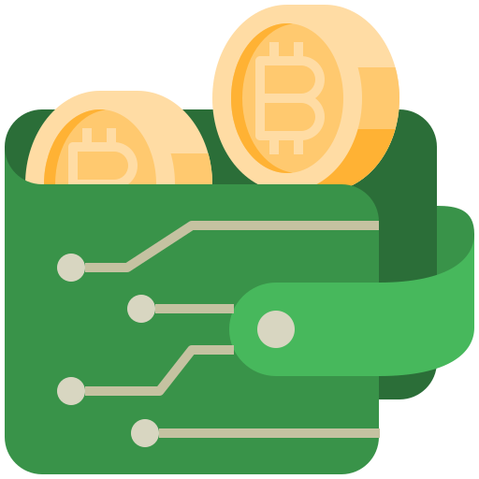

How to spend and receive crypto ?
We use a Wallet
pair of two numbers, a public key and a private key
Private key :
Secret number that allows users to spend or transfer
cryptocurrency from their wallet, allows you to sign transactions
Public key :
create a digital signature that verifies ownership of the funds in the wallet
And permits to sign transactions
/!\ Keep your private key safe !
If someone has your private key, he has control over your funds…
Notes:
A wallet is simply a pair of two numbers, a public key and a private key. The bitcoin address is derived from the public key.
After hash, the second major element of cryptography: asymmetric cryptography.
The public key (or, more specifically, the bitcoin address that comes from it) allows you to receive funds, and the private key allows you to sign transactions.
This private key is not stored on the blockchain, it is your responsibility to store it in a secure place. This key can be generated offline, without any access to the Internet.
The key itself is never published on the blockchain (or on the internet). What is published are "messages", transactions, signed by this key.
The cryptographic properties of your public key / private key pair allow anyone to verify that a transaction has been signed by your private key, without needing to know it.
It is this mechanism that allows you to spend the balance of your account.
It also means that if a person manages to get a copy of your private key, they can spend your balance on you.
Thus, you never really store ”your bitcoins" somewhere. What you store, however, is the private key that allows you to spend them.
There is a saying in the blockchain ecosystem that says "not your keys, not your bitcoins" and that conveys the idea that as long as you don't have the private key of your wallet in hand, it's that someone else has it and can do what they like with it. This advice is particularly aimed at people who leave cryptoassets on exchanges (market places where you can acquire cryptoassets). As long as cryptoassets are on the exchange, it's him (not you!) who controls the private keys.

Slide 7

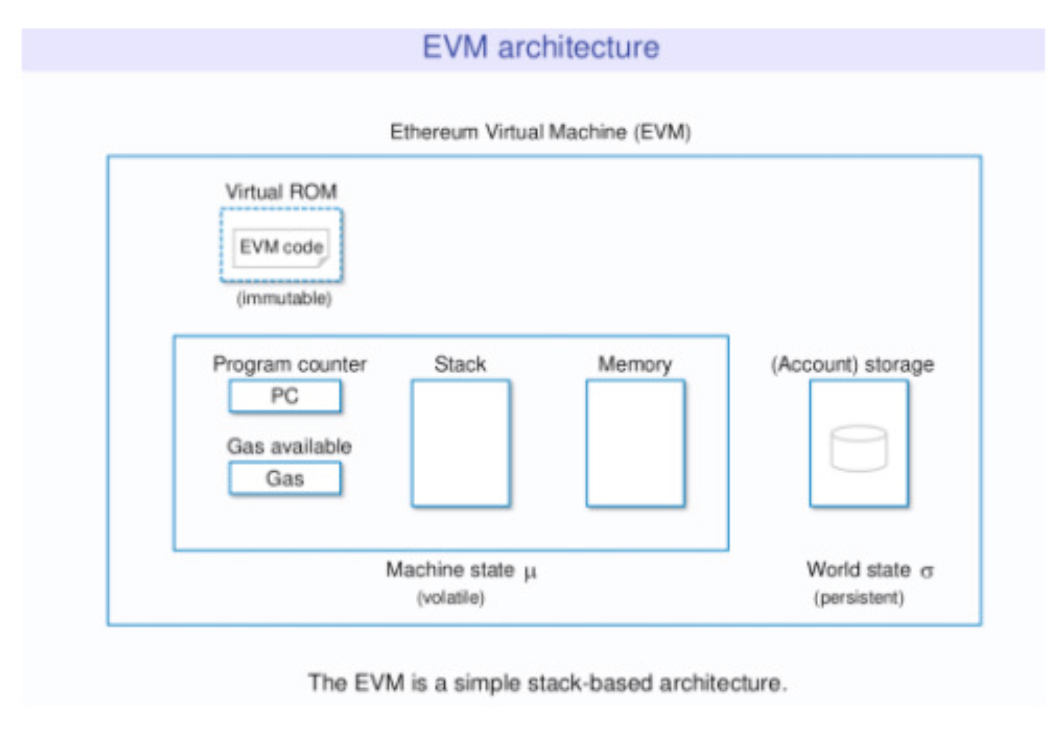
What is Ethereum ?
Blockchain / Global and open-source platform for decentralized applications
Make digital currency transfers (as Bitcoin)
But more flexible
Deploy your own code via Smart Contracts
Interact with applications created by others
Uses the EVM
(Ethereum Virtual Machine)
Designed and imagined in 2013 by Vitalik Buterin
Execute code stored on the blockchain
Ether == Ethereum ?
Ether (ETH): the currency
Ethereum: the network itself
(lots of useful explanations in ’note’ section)
Notes:
Ethereum is a global and open-source platform for decentralized applications.
It works simultaneously on several servers around the world.
Like Bitcoin and other cryptocurrencies, Ethereum allows you to make digital currency transfers.
However, it is more flexible and is capable of much more - you can deploy your own code there via smart contracts and interact with applications created by other users.
It uses a virtual machine (EVM) to execute code that is stored on the Ethereum blockchain, enabling nodes to verify transactions and create new blocks on the chain.
How was Ethereum created?
This protocol was designed and imagined in 2013 by Vitalik Buterin at the age of 19.
Realizing that it was difficult to implement new features on
Bitcoin, he publishes a description of his Ethereum project in the form of a white paper and in a 2013 blog post entitled Ethereum: The Ultimate Smart Contract and Decentralized Application Platform.
To finance the development of the project Vitalik Buterin pre-sale the first Ethers in a public token sale called Initial Coin Offering
(ICO), where those who wanted to participate could buy Ether tokens in exchange for bitcoins or fiat currency.
The sale then allowed him to collect 31,529 bitcoins worth more than $18 million at the time, for 60 million Ethers sold. Thanks to this sale, the Ethereum Blockchain was launched on July 30, 2015.
In 2016, Ethereum's White Paper was published. You can consult the original version here or the translated version here : https://whitepaper.io/document/5/ethereum-whitepaper
ETHER != ETHEREUM
The Ethereum protocol uses units, ethers, which are the currency on which this technology is based. Ethereum refers to the network itself and ether (or ETH) represents the native currency used on this Blockchain.
Ether can be sent instantly to anyone on the Ethereum network, and can be used in many Ethereum-based applications. (see the following link: https://ethereum.org/en/dapps/)
HOW DOES ETHEREUM WORKS ?
The Ethereum network consists of several interconnected computers spread around the world. These computers are called network nodes. These nodes are intended to keep a copy of the blockchain registry and maintain the security of the system.
Ethereum can be defined as a state machine that tracks all the state transitions of each account and smart contract. Indeed, some actions result in a state update, which means that all nodes must also update their own copies to reflect these changes.
The management of the internal state of the network is done through the virtual machine
Ethereum (EVM) which is considered the most important element of
Ethereum. The machine must follow the status of many components in order to be able to successfully handle a transaction.
As in the rest of computer science, a state machine refers to a machine capable of reading a series of inputs and, depending on these inputs, switching to a new state. The Ethereum virtual machine works in the same way by constantly checking if new transactions have been sent.
Before making transactions on Ethereum, the starting point is a kind of blank slate - we refer to the "Gesthes block", which is the first block of a blockchain. As transactions on the network are executed, any point during this time represents the current state of Ethereum.

Slide 8
Transactions on Ethereum
Transaction: signed data packet that contains a defined number of properties to be sent from one account to another on the Blockchain
Internal Transaction (messages): virtual object that only exists in the Ethereum execution environment.
Sent by smart contracts or accounts to other smart contracts. Can be assimilated to functions call.
Their structure:
• sender of the message
• recipient of the message
• signature identifies the sender and demonstrates his intention to send the message
• VALUE field - the amount in wei (the smallest subdivision of ether) to be transferred
• optional data field, which may contain the message sent to a contract
• GASLIMIT value, maximum number of calculation steps that the transaction is authorized to carry out
• GASPRICE value, commission that the sender is willing to spend for each unit of gas.
Notes:
TRANSACTIONS
Transactions on Ethereum refer to a signed data packet that contains a defined number of properties to be sent from one account to another on the Blockchain. Transactions are not free, they have a gas price, we will see that later.
INTERNAL TRANSACTIONS (OR MESSAGES)
Messages are virtual objects that are never serialized* and only exist in the Ethereum execution environment. They are sent by smart contracts or accounts to other smart contracts.
They can be assimilated to functions calls.
A message is like a classic transaction, except that it is produced by a contract and not by an external actor. - Messages are also sometimes called "internal transactions".
*Explanation: serialization: In computer science, serialization is the coding of information in the form of a series of smaller information (called atomic, see the etymology of atom) for, for example, its backup (persistence) or its transport over the network (proxy, RPC...).
THEIR STRUCTURE
A transaction contains the following information:
• the sender of the message
• the recipient of the message
• a signature that identifies the sender and demonstrates his intention to send the message via the blockchain to the recipient
• a VALUE field - the amount in wei (the smallest subdivision of ether) to be transferred from the sender to the recipient
• an optional data field, which may contain the message sent to a contract
• a GASLIMIT value, representing the maximum number of calculation steps that the transaction is authorized to carry out
• a GASPRICE value, representing the commission that the sender is willing to spend for each unit of gas. A unit of gas corresponds to the execution of an atomic instruction, i.e. a calculation step

Slide 9
What’s the gas on Ethereum ?
Make a transaction
Why make users pay ?
Modify the state of the blockchain
• In order to prevent deliberate attacks and abuses on the
Ethereum network including attacks via "spam" transactions
• In order to pay for network nodes that consume for the common good
Executed on each node
Has a cost
GAS: execution fees that transaction senders must pay for each transaction made on the Ethereum Blockchain
(lots of useful explanations in ’note’ section)
Notes:
When you run a decentralized application (Dapp), you interact with the Blockchain to read and change its status. Indeed, following the execution of a smart contract, each instruction is executed on each node of the network. We will have to pay a specific cost for each operation carried out, expressed in the number of gas units.
Why make users pay?
• In order to prevent deliberate attacks and abuses on the Ethereum network - including attacks via "spam" transactions (DDoS distributed denial of service attacks)
• In order to pay for network nodes that consume for the common good
Gas represents the execution fees that transaction senders must pay for each transaction made on the Ethereum Blockchain. The name "gas" is inspired by the idea that these costs act as a fuel.
As a car cannot drive without fuel, a smart contract cannot be executed without gas.
It should be noted that gas and ether are two distinct concepts. Gas units represent the cost in computing power of a basic operation, expressed with a fixed cost.
On the other hand, the price of ether generally fluctuates according to supply and demand on the market. Both are subject to the mediation of a free market: the price of gas is in fact decided by miners, who can refuse to process a transaction whose gas price is below their minimum limit.
Each transaction must include a gas limit and the fees to be paid per gas.
Minors then have the choice to include the transaction and collect the fees or not.
If the total amount of gas used by the transaction is less than or equal to the gas limit, then the transaction is processed.
If the total amount of gas exceeds the gas limit, then all changes are cancelled, except that the transaction is still valid and the fees can still be collected by the miner.
All excess gas not used by the execution of the transaction is refunded to the sender in the form of ether.
You don't have to worry about excessive expenses, since you are only charged for the gas you consume.
This means that it is both useful and more secure to send transactions with a gas limit much higher than estimates.

Slide 10
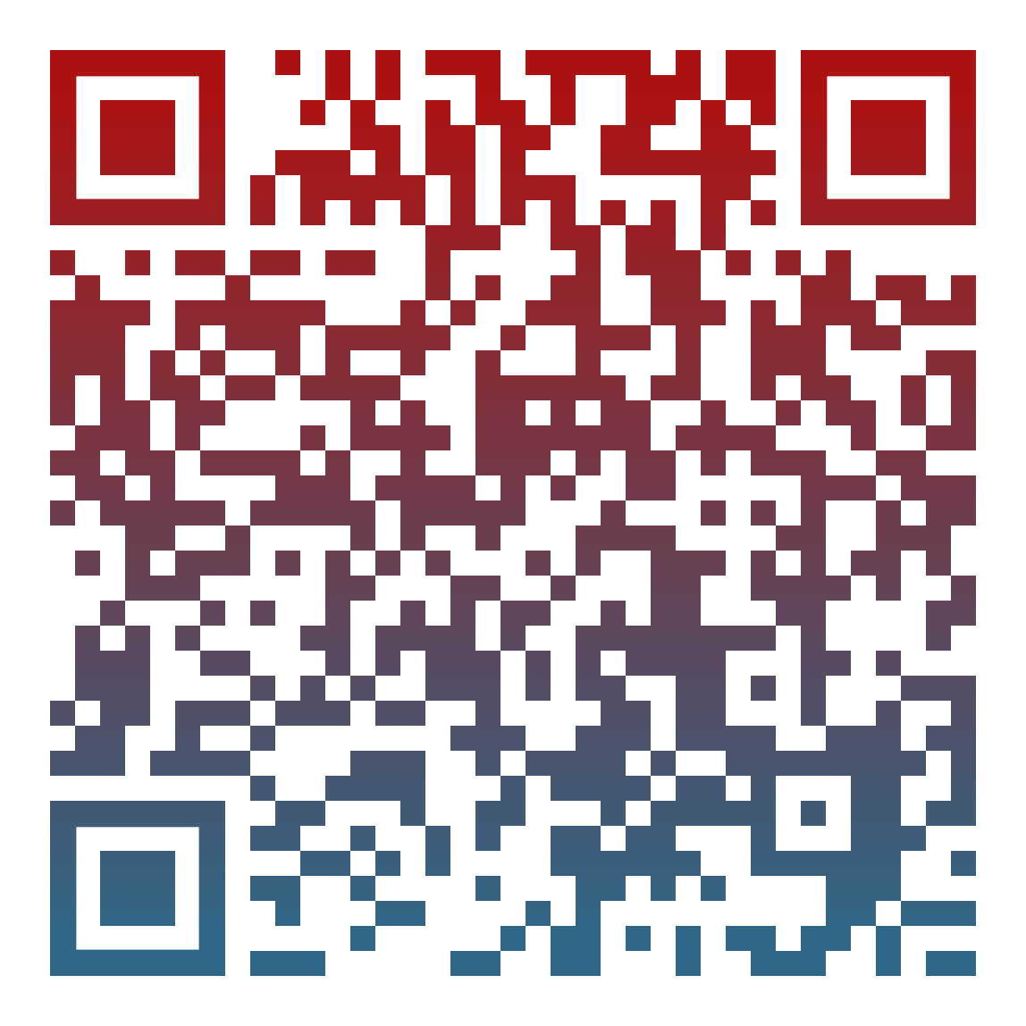
QUIZ TIME !
https://create.kahoot.it/share/ethereum-quizz/728249f9-6703-423a-baca-a3296e4a1bb7
Notes:
https://create.kahoot.it/share/ethereum-quizz/728249f9-6703-423a-baca-a3296e4a1bb7

Slide 11
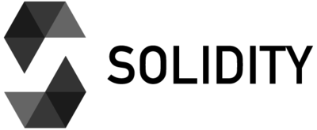
Smart Contracts on Ethereum
But what is it ?
Set of
codes (its functions)
data (its status)
attached to a specific address on the Ethereum Blockchain
EVM
Low level machine instruction
Compilation
High level language
Ethereum Requests Comment (ERC)
Some standards:
(generally presented via the
Ethereum Improvement Proposals (EIP))
standard smart-contract format
• ERC20 - A standard interface for tokens
• ERC721 - A standard interface for non-fungible tokens (NFT)
Notes:
A smart contract is a set of codes (its functions) and data (its status) attached to a specific address on the Ethereum Blockchain.
Smart contracts are recorded using a creation transaction - deployment - on the Blockchain in an Ethereum-specific binary format called bytecode.
Smart contracts are usually written in a high-level language such as Solidity. These languages cannot be executed directly by the EVM. Instead, they are compiled into low-level machine instructions to be registered on the Blockchain.
Unlike Ethereum, smart contracts on Bitcoin are written in a low-level language using opcodes and are called "scripts".
STANDARDS - EIP
The Ethereum community has adopted many standards useful to developers. These standards are generally presented via the Ethereum Improvement Proposals (EIP), which are proposals for improvements that members discuss according to a standard process.
https://eips.ethereum.org/
Some EIPs relate to application-level standards (for example, a standard smart-contract format), which are introduced as Ethereum Requests Comment (ERC). Many ERCs are the essential standards that are widely used in the Ethereum ecosystem.
https://eips.ethereum.org/erc
Two of the most famous are the ERC20 and ERC721.
• ERC20 - A standard interface for tokens
• ERC721 - A standard interface for non-fungible tokens (non-fungible tokens)

Slide 12
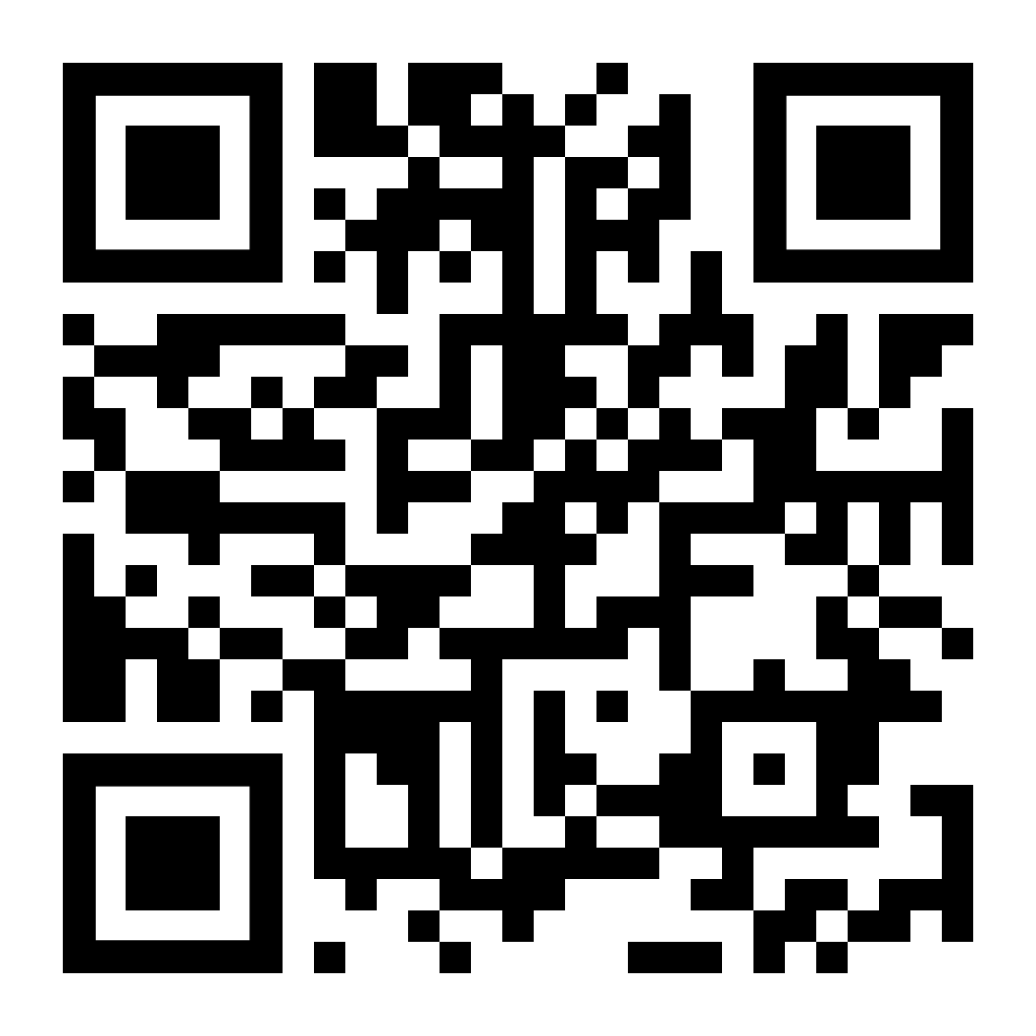
Opcodes and Bytecodes
EVM
Low level machine instruction
Compilation
OPCODES
High level language
List of all opcodes
OPCODES
On 1 byte
BYTECODES
(ex. STOP is 0x00)
will be recorded on the Blockchain
Why in hexadecimal?
Because this is the language that the EVM understands!
Notes:
OPCODES
In order to register a smart contract on the Blockchain, we must go through an essential step that is compilation.
The compilation allows the translation of high-level language such as Solidity to a low-level language understandable by the machine. This translation is done at the Ethereum virtual machine (EVM) level by the compiler to obtain machine instructions called opcode.
These opcodes are intended to perform specific tasks. Here is the list of the different opcodes available today:
https://github.com/crytic/evm-opcodes
BYTECODES
In order to efficiently store opcodes, they are coded in bytecode. Each opcode has allocated one byte (for example, STOP is 0x00). It is this bytecode that will be recorded on the Blockchain.
(Have you ever wondered why there is an "Ox" in front of your wallet address, your hash transaction or even the bytecode of a smart contract?
Anything that starts with "Ox" simply means that the value is in hexadecimal format.
Why in hexadecimal?
Because this is the language that the EVM understands! It is not mandatory to have an "Ox" in front of a hexadecimal because ('EVM will treat any value as a hexadecimal, regardless of its shape (by adding "O×").

Slide 13
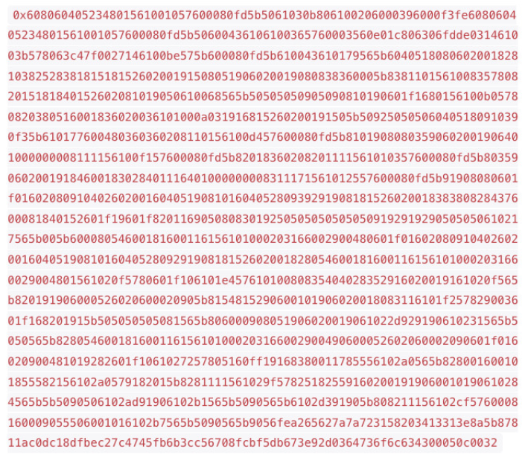
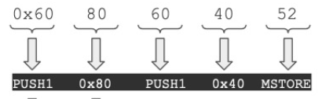
Opcodes and Bytecodes
List of all opcodes
Operation
Value
QUIZ TIME !!!
https://create.kahoot.it/share/quiz-bytecodes-opcodes/ffdfb45e-ad82-471a-979e-cdf54bf05b1f
Notes:
https://create.kahoot.it/share/quiz-bytecodes-opcodes/ffdfb45e-ad82-471a-979e-cdf54bf05b1f

Slide 14
How to create a smart contract ?
Write the smart contract
Compile it
Publish it to the network
How ? With a development environment or with an online tool that we will see later
The tools will call the distant node, synchronised with the blockchain
and it will publish it
Now everyone can interact with it !!
How ? With a unique address that is attributed to it
Notes:
On Ethereum, a developer writes his smart contract that he will compile. Once validated, it publishes it on the network! How does he send it? The developer will use a development environment, or an online tool, which we will see later. The tools will call a remote node, synchronized with the blockchain, to publish the smart contract. We will of course come back to it later.
From this stage, everyone will be able to interact with the contract, and it can no longer be modified.
But how to interact with this contract?
When the contract is published, a unique address is assigned to it. Users of the application can use a specific function via a transaction that triggers the execution of the contract code.
It will be enough for the user to have an abstraction of the contract and his address to call him!

Slide 15
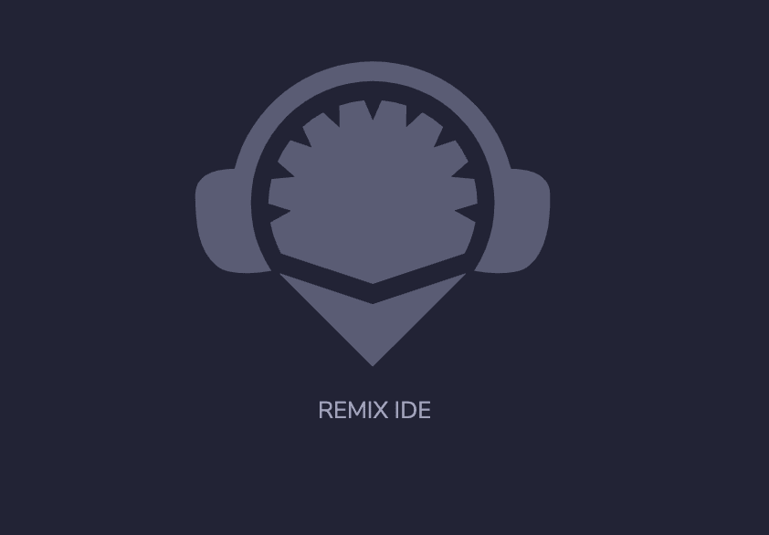
How to write your first contract ?
Let’s code !
You will now write a simple contract that store a value in it !
To do so we will use REMIX IDE
https://remix.ethereum.org
• Easy to use and configure. everything is integrated and accessible by your browser.
• Automatically has the latest versions of Solidity.
• Has a built-in debugger.
• Allows you to compile and execute smart contracts instantly on any network of the Ethereum Blockchain
• Has a Javascript VM that allows you to simulate a private Blockchain. To perform tests, an Ethereum
account list is created where each account is fed 100 ETH.
Notes:
Remix is a powerful and open source tool that helps you write smart contracts (in Solidity or Vyper) directly from your browser. This IDE (Integrated Development Environment) written in JavaScript, can be used both in the browser and locally.
Remix also allows you to test, debug and deploy smart contracts and much more.
It is accessible at https://remix.ethereum.org.
REMIX: THE POSITIVE POINTS
Remix is very practical and very relevant to learn to code on Solidity for several reasons:
• Easy to use and configure. You do not need to install anything, everything is integrated and accessible by your browser.
• Automatically has the latest versions of Solidity.
• Has a built-in debugger.
• Allows you to compile and execute smart contracts instantly on any network of the Ethereum Blockchain (mainnet, testnet or even private).
• Has a Javascript VM that allows you to simulate a private Blockchain to facilitate use and learning. To perform tests, an Ethereum account list is created where each account is fed 100 ETH.
REMIX: THE NEGATIVE POINTS
You have understood it! Remix is very practical, however it has its own disadvantages, including:
• Online IDE and therefore you have to think about managing files and using the desktop version or publishing smart contracts on github to avoid any loss
• Non-management of complex projects. Its use is limited to the creation of smart contracts. So, to create Blockchain projects you have to go through another IDE (visual studio code, webStorm, Ethereum studio....)

Slide 16
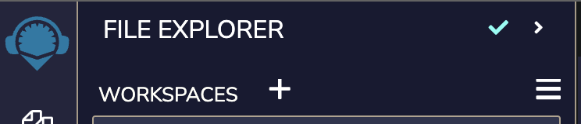
Let’s write the first contract !
Go on https://remix.ethereum.org
Create a new workspace
Create a new file named ‘simpleStorage.sol’
Start to code here !
Store a simple integer in it and set it to 100 !
Now try to create a new contract called HelloWord and store a string !
pragma solidity >=0.8.0 <0.8.9;
contract SimpleStorage {
}
(hint: a simple integer is noted uint)
Notes:
Any Solidity source code must start with a "pragma version" - a declaration of the Solidity compiler version that this code must use. This prevents future versions of the compiler from introducing changes that could break your code.
As part of this workshop, we will use any compiler version between 0.8.0 (included) and 0.8.9 (exclusive). It looks like this
Pragma solidity >=0.8.0 <0.8.9;

Slide 17
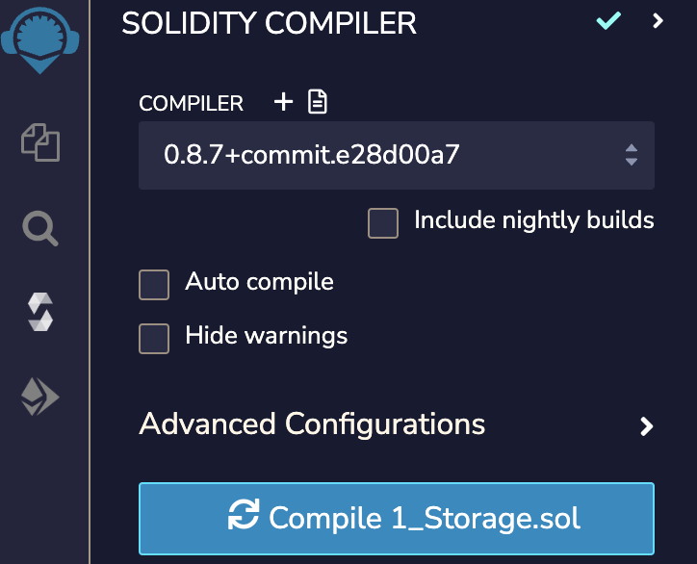
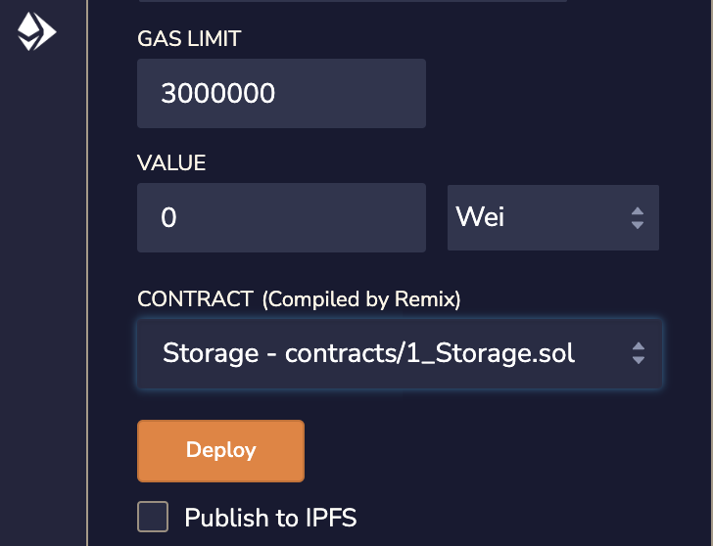
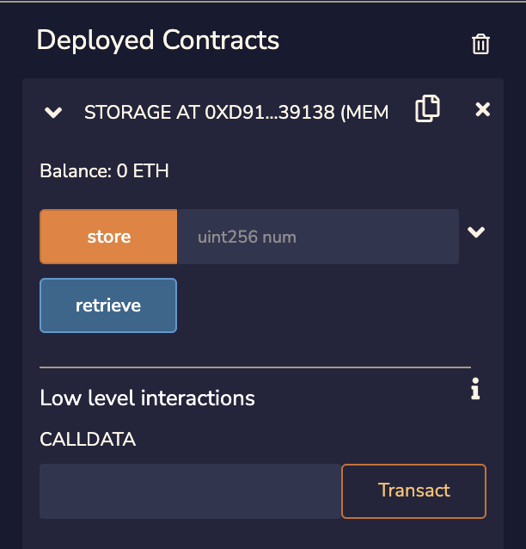
Create some functions and deploy your contract!
In the contract simple storage
Store an integer called data
Add a function set(), takes an integer as parameter and assign it to data
Add a function get(), returns data
Now we are going to deploy it !
Compile
Interact
Deploy
Notes:
In a contract called SimpleStorage, store a integer called data, add two functions, set() that doesn’t return anything, just set data to the value we pass as parameter, and get() that return data
Deploy the following smart contract on the using remix.
First open the contract you want to deploy, then click on the solidity logo on the left and click on compile. Once it’s done click on the Ethereum logo and then on deploy.
Now that your contract is deployed you can see just under an interface with buttons in order to interact with your contract !

Slide 18
Quiz time !
https://create.kahoot.it/share/quizz-remix/60a11893-50cb-4d54-8e69-d9f91915f00d
Notes:
Little quiz about remix

Slide 19
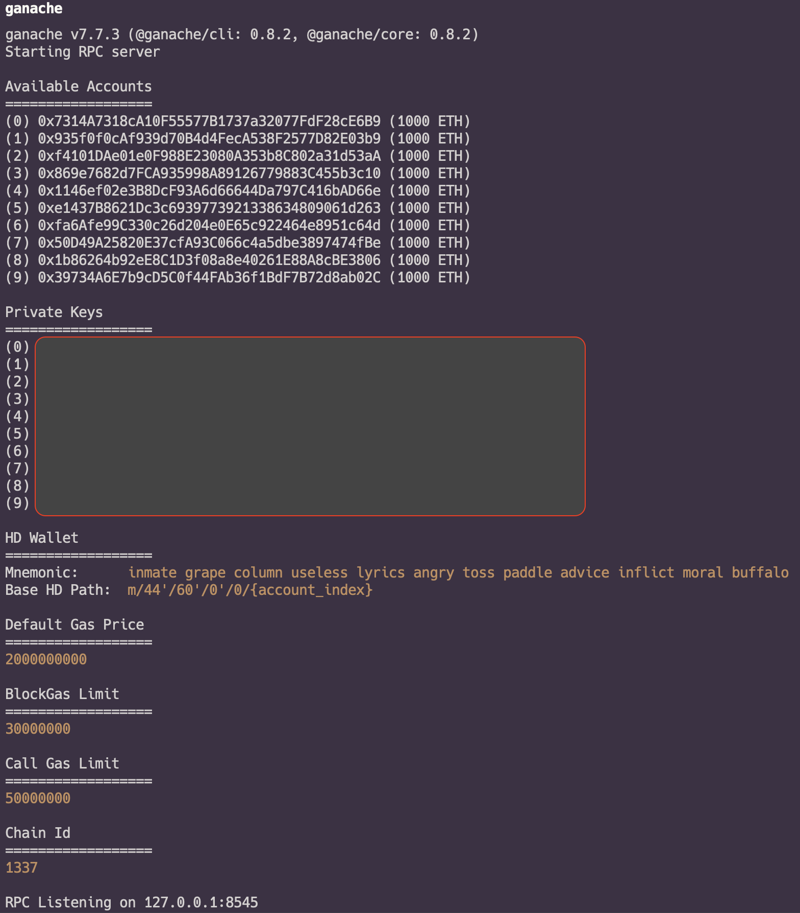


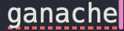
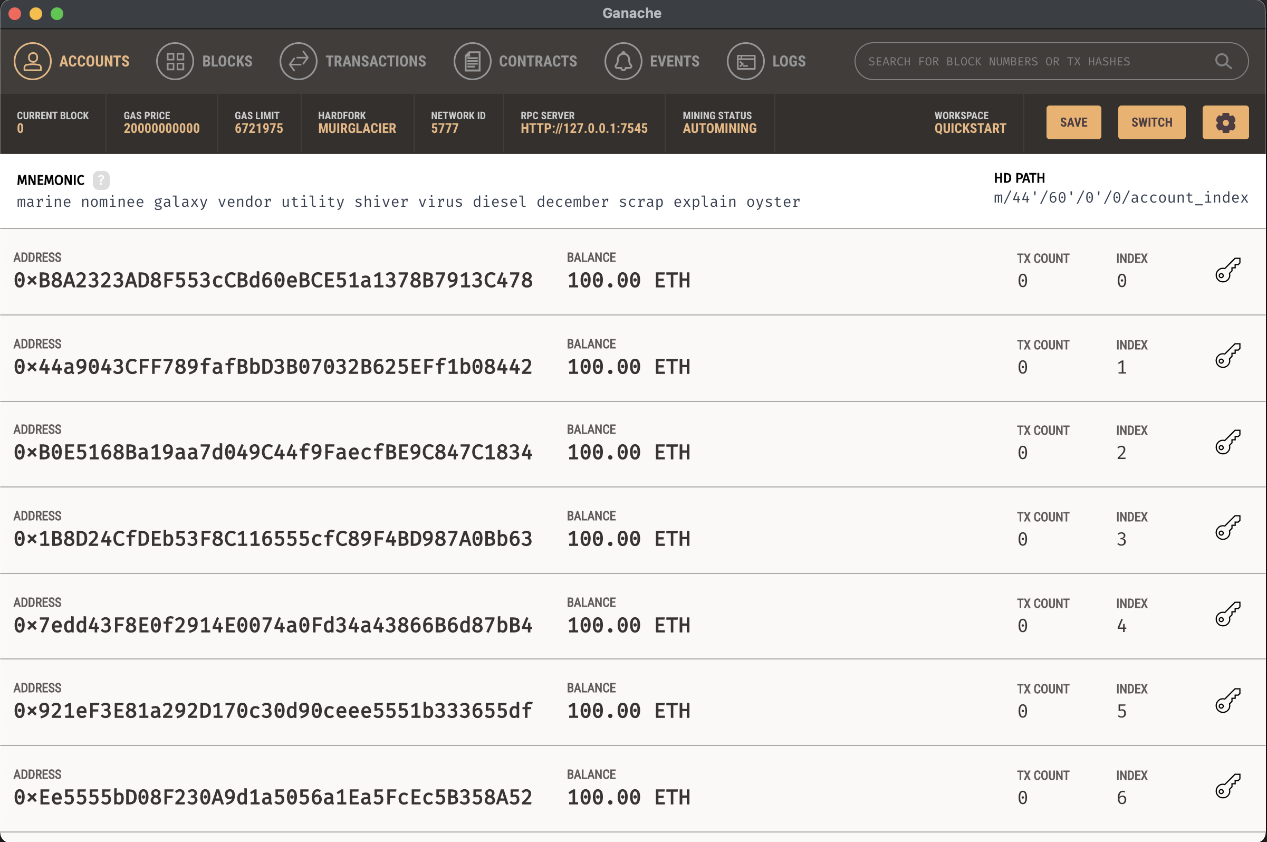
Now we will deploy it on your own blockchain !
With ganache
Command line:
Desktop App
Click on
’Quickstart Ethereum’
Notes:
You can either use ganache as a desktop app or via command line
For the command line run:
$ npm install ganache –global
$ ganache
Please to the official github: https://github.com/trufflesuite/ganache

Slide 20
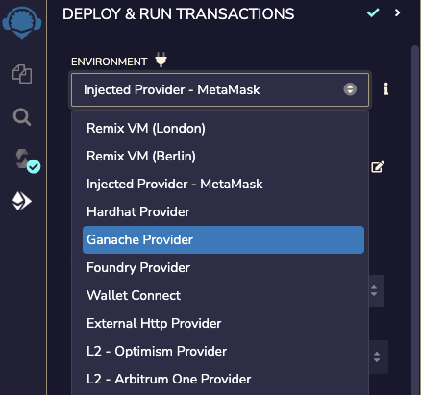
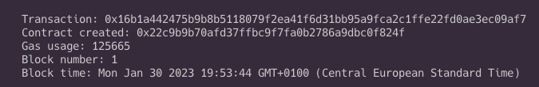
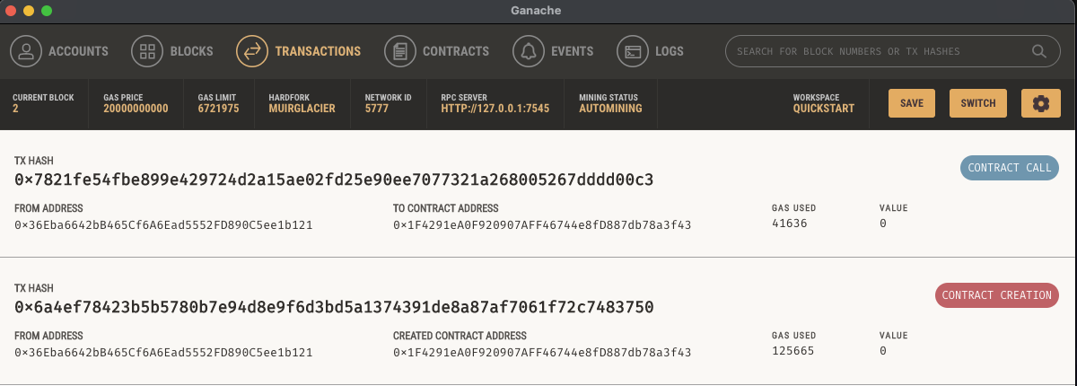
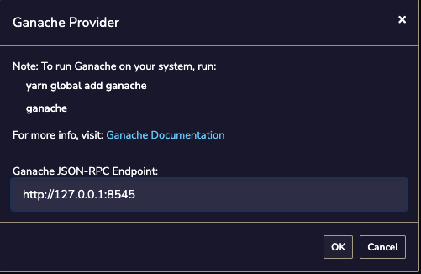
Now that you have your blockchain let’s deploy the contract on it !
Notes:
On remix change the environment for ganache
Be careful with the used port, normally if you run ganache from the terminal it will be 8545 and from the desktop app 7545.
Now when you interact with your contract you will be able to see everything that is happening on the app or in your terminal

Slide 21

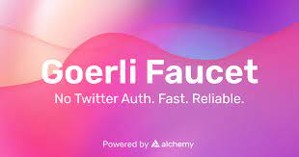
Now you will deploy it to a testnet ! (georli)
Get a Metamask wallet and use the Georli testnet network
Go on https://goerlifaucet.com/ and request some fake ETH
Notes:
You can deploy your contracts to a testnet in order to test it and for other people to interact with it.
For this step you will first need to create a metamask wallet.
Once you have it you will want to go in the settings in order to allow the display off the test nets in case you don’t already have them.
In order to deploy a contract and interact with it you need to pay some gas. But when your are testing you don’t actually want to pay, this is why we use a testnet and a faucet in order to obtain some fake ETH.
Multiple faucets exist but here we will use https://goerlifaucet.com/
Go on it create an account and request some Goerli ETH.

Slide 22
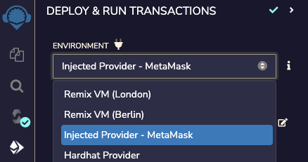
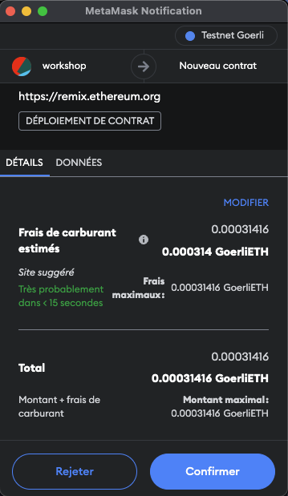

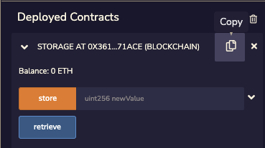
Go back to remix and our smart contract
Notes:
The same way as earlier go on remix and change again the environment, choose metamask. When you do it your address should appear in the ‘account’ section.
But this time when you will click on deploy a popup will appear asking you to confirm the transaction. Transaction being deploying the contract on the network
As always you can interact with the contract but each time metamask asks the confirmation in order to pay the fees.
But the difference is that in this case you can copy the contract’s address and go on goerli.etherscan.io in order to check everything that is happening with your contract. The person interacting with it, the value stored in it etc…
(Also you can click directly on the link present in the logs of remix or in the transactions on metamask)

